Slide 1
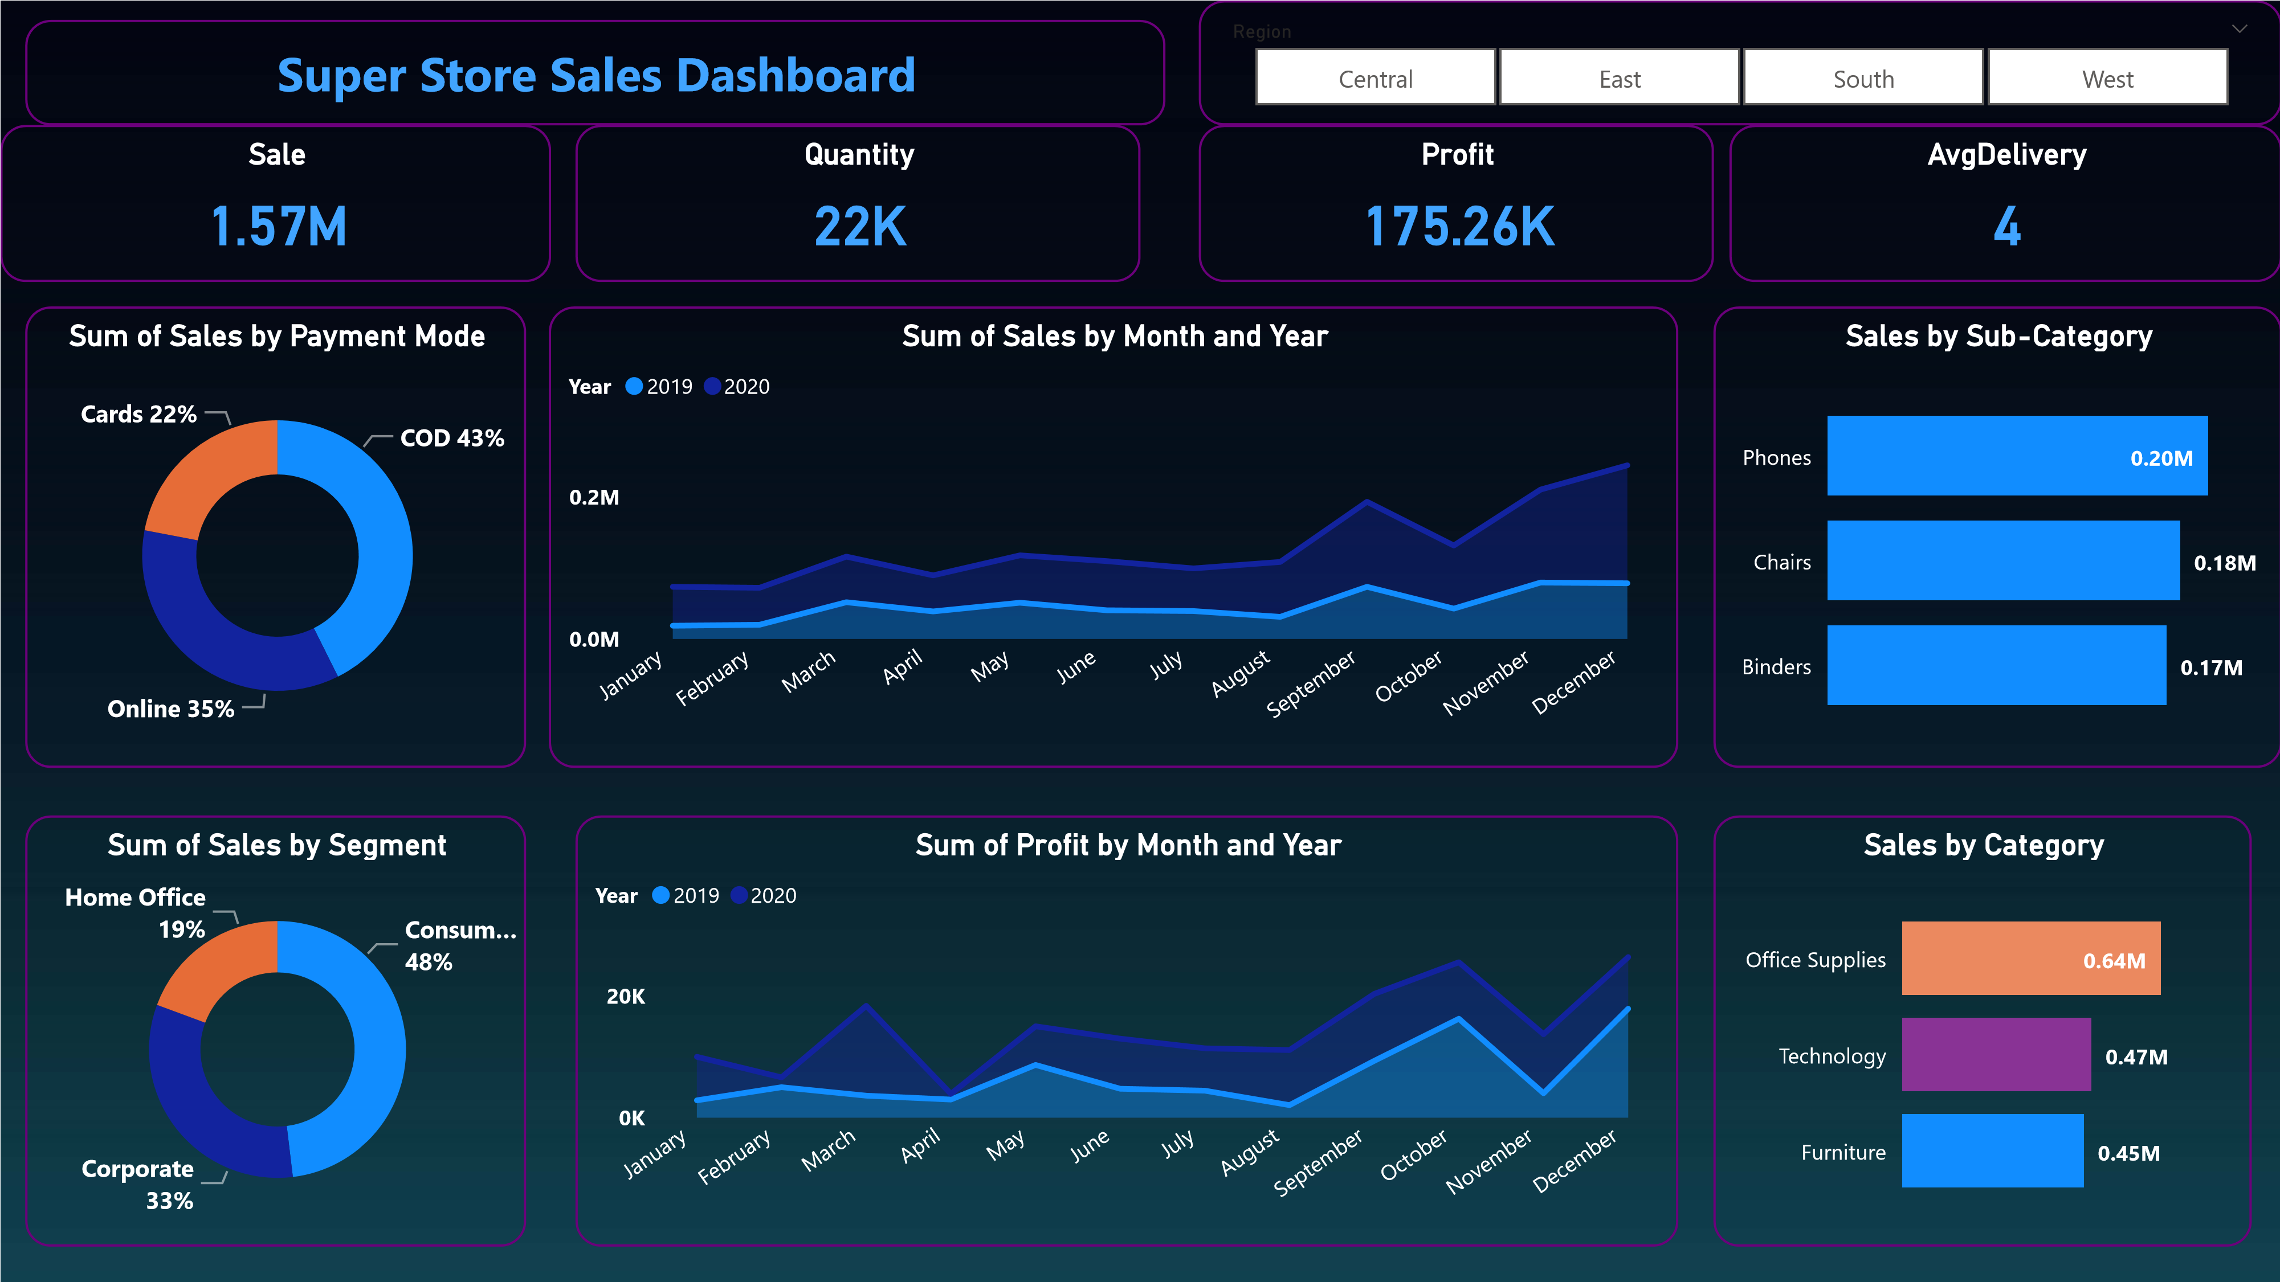

Slide 2
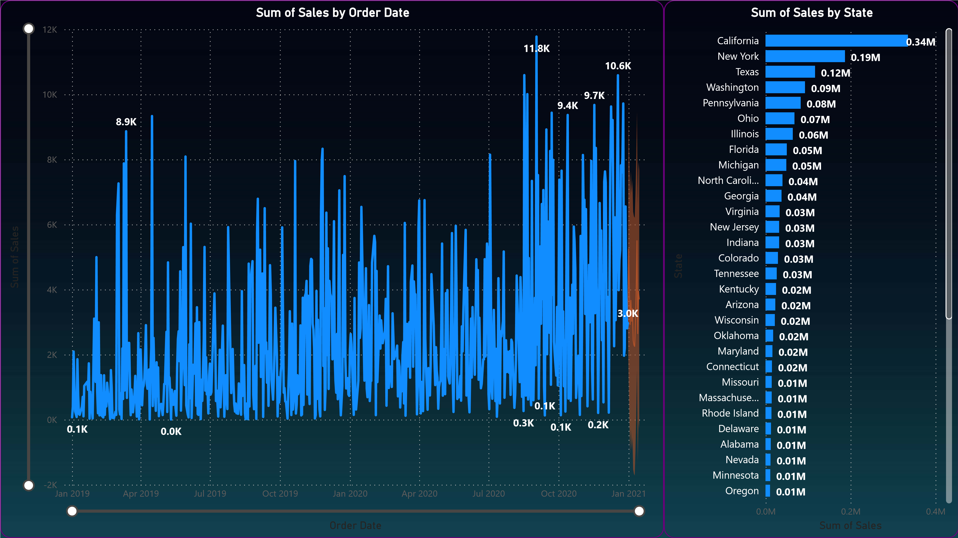
Sales forecasting for next 15 days

Slide 3
OBJECTIVE
To contribute the success of a business by utilizing data analysis techniques, specifically focusing on time series analysis, to provide valuable insights and accurate sales forecasting.

Slide 4
DESCRIPTION
The objective is to broken down into following detailed components;
Dashboard Creation: Identify the KPIs, design an intuitive and visually appealing dashboard, and interactive visualizations and filtering capabilities to allow users to explore the data at various level of granularity.
Data Analysis: Provide valuable insights to business entities regarding the effectiveness of the sales strategies through visualization and charts.
Sales forecasting: Leverage historic data and apply time series and generate sales forecasting for next 15 days.
Actionable insights and Recommendation: End goal is to handle insights and actionable information that can drive strategic decision and support the supermarkets goals for growth, efficiency, satisfaction.

